Slide 1
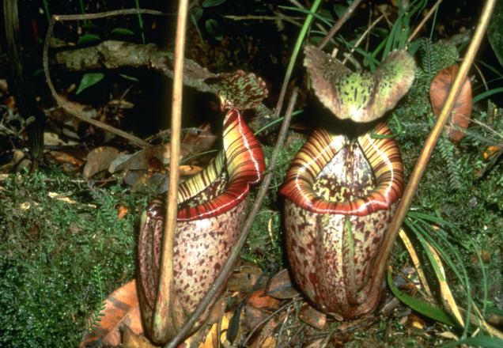
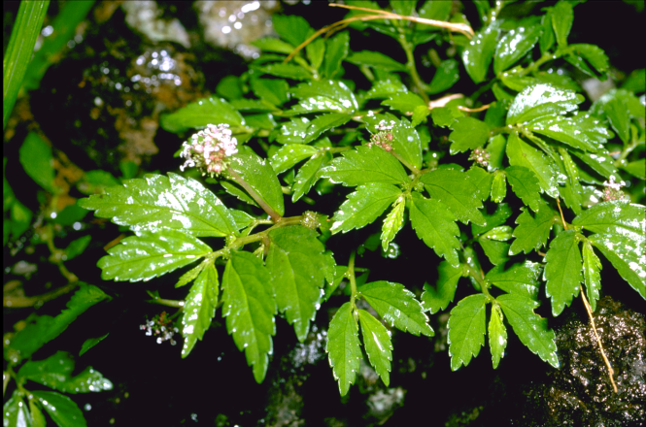
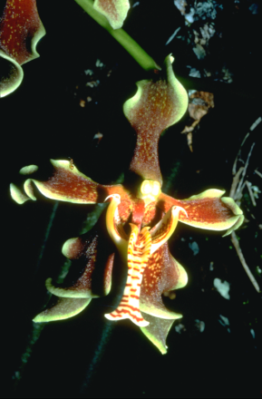
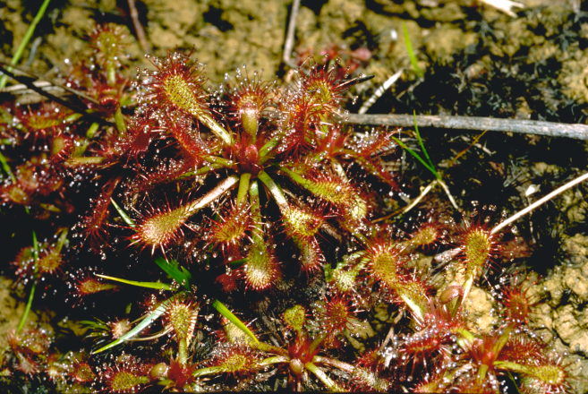
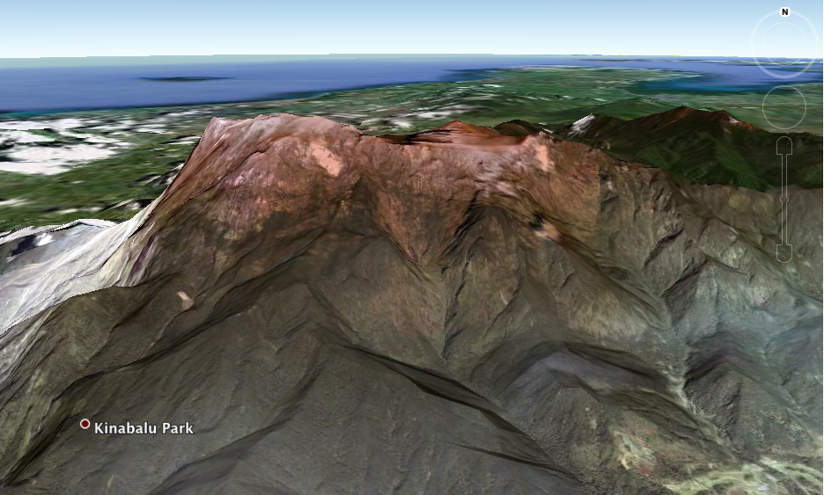
Biodiversity Data Exchange Using PRAGMA Cloud
Mount Kinabalu biodiversity interoperability experiment
Umashanthi Pavalanathan, Aimee Stewart, Reed Beaman, Shahir Shamsir
C. J. Grady, Beth Plale

Slide 2




Experimenters, infrastructure, and data providers
U. Pavalanathan B. Plale
A. Stewart C.J. Grady
S. Shamsir
S.N. Azmy
C.T. Han
R. Beaman A. Weischselbaumer

Slide 3
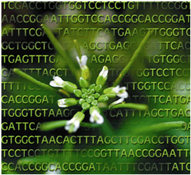




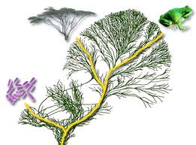
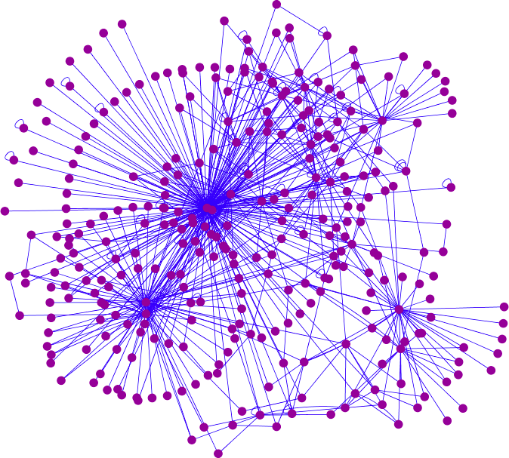
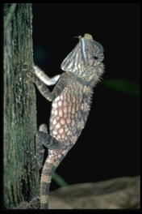
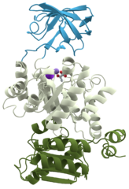
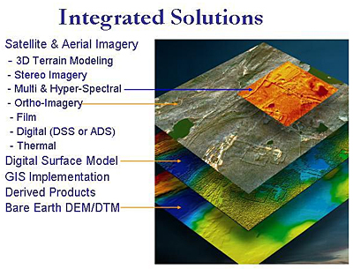
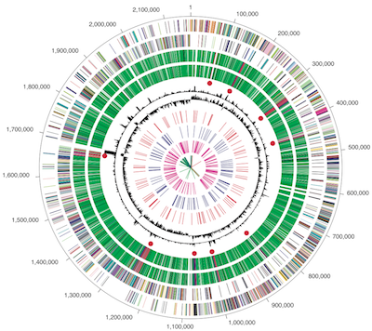
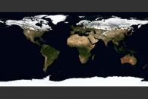
Biodiversity Research
Examines variation and interaction among living things and complex systems
Fundamental to a healthy and sustainable planet
Loss is a leading environmental and social issue
.

Slide 4
Motivation
Biodiversity applications are data driven by nature
Distribution patterns can be revealed through analysis of large volumes of species occurrence data using techniques such as species distribution modeling
Analysis tools, data discovery methods, and cloud computing all contribute to the solution

Slide 5
Rationale for the interoperability experiment
Opening opportunities to do biodiversity research with scalable infrastructure
Improving access to shared data
Forming a Community of Practice through collaborations in biology, information sciences, computer science, engineering

Slide 6
Experiment
Proof of concept biodiversity application utilizing distributed data and doing useful data exchange in the PRAGMA cloud
Basic application of species distribution modeling using Lifemapper LmSDM

Slide 7
Data
Specimen collection records illustrating plant diversity on Mount Kinabalu, notable for its high diversity and endemism of species and ultramafic environments
Metadata files describing nine species distribution data sets are uploaded to a GeoPortal server running at Universiti Teknologi Malaysia (UTM)

Slide 8
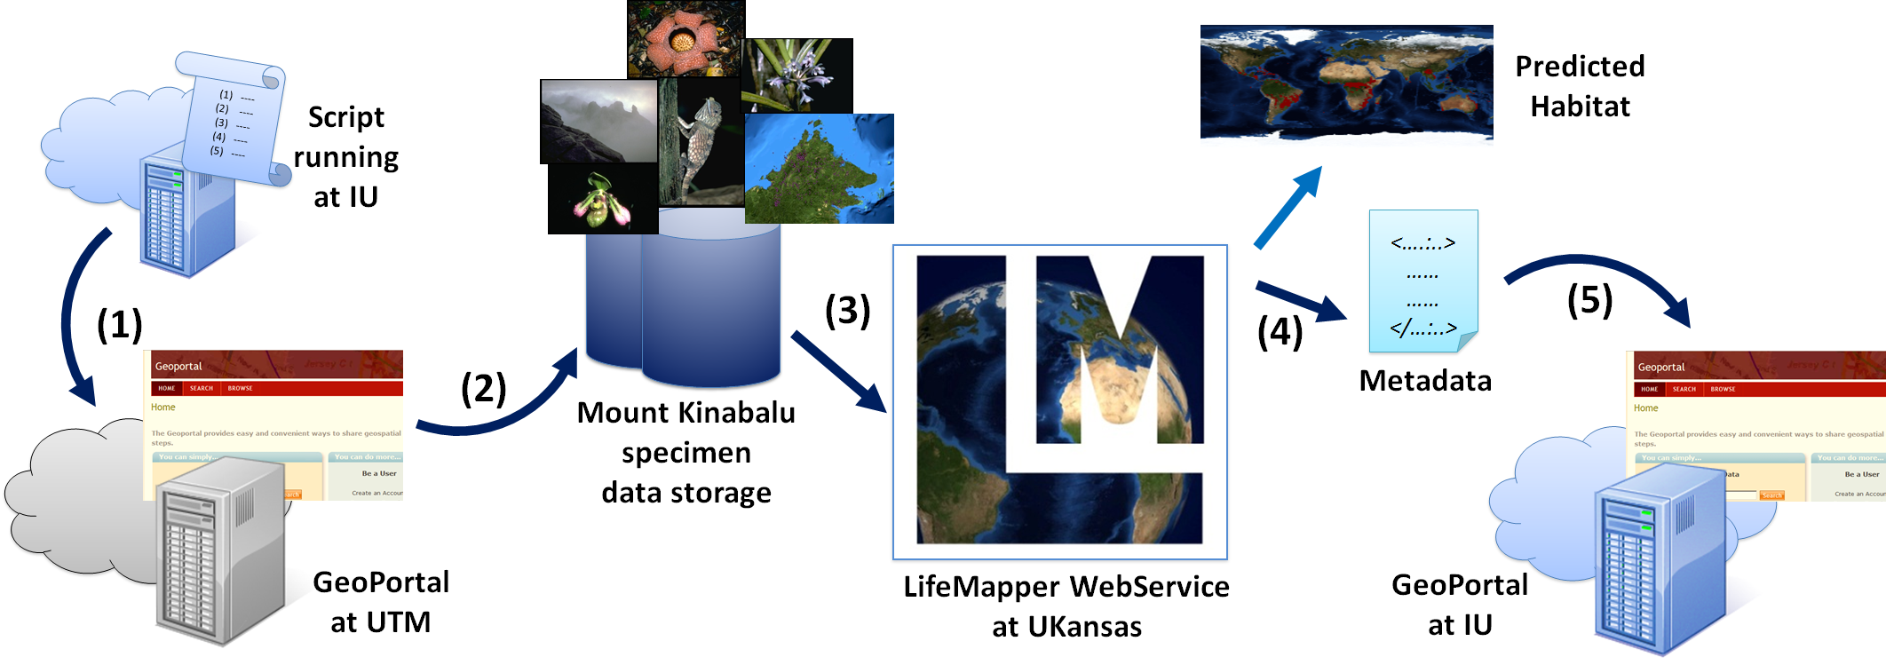
Workflow
Notes:
Step 1:
A script running at the Indiana University (IU) PRAGMA node queries the GeoPortal server running at UTM. Retrieves metadata describing raster datasets of Mount Kinabalu, environmental and satellite data, and point occurrences of specimen collections
Step 2:
By analyzing the resulting metadata records, the script downloads the datasets stored in a Dropbox location
Step 3:
Script posts the data sets as occurrence sets to the Lifemapper instance running at University of Kansas. Using the returned occurrence set identifiers, the script submits post experiment requests to Lifemapper
Step 4:
Script retrieves metadata results returned for each Lifemapper experiment
Step 5:
Script catalogs provenance metadata describing each experiment, along with the URL for Lifemapper prediction outputs, in a GeoPortal server instance running at IU

Slide 9
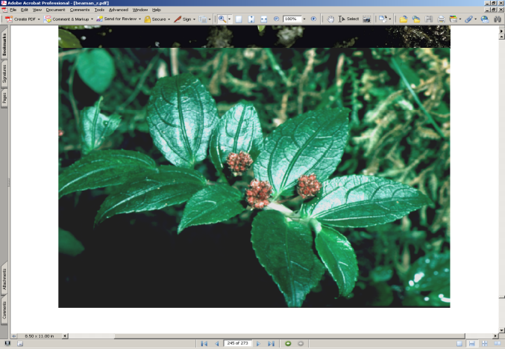
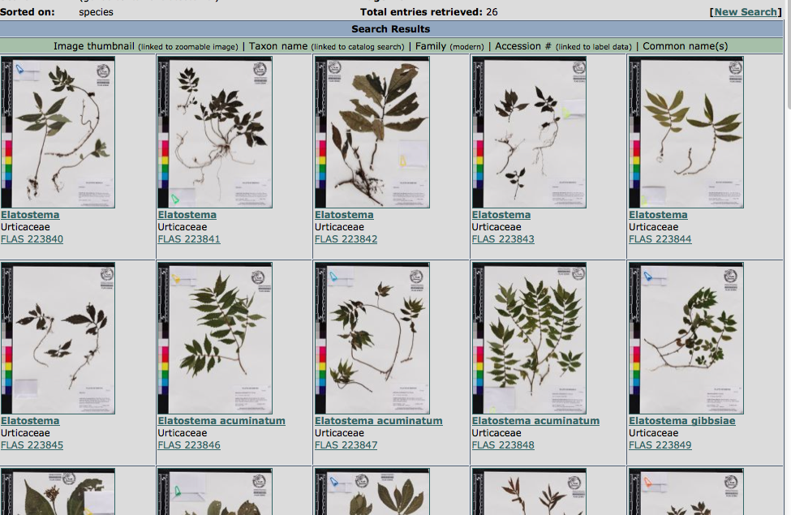
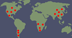

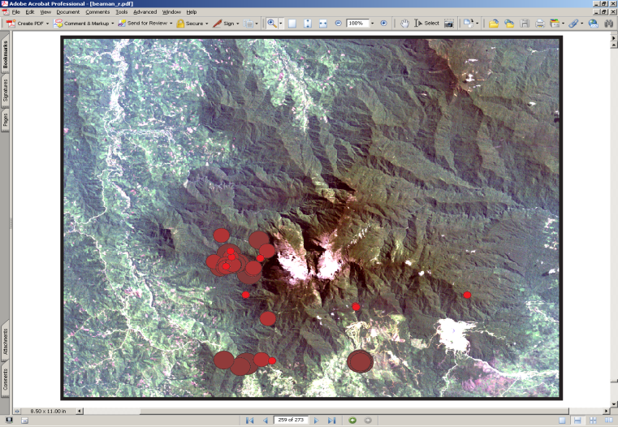


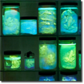



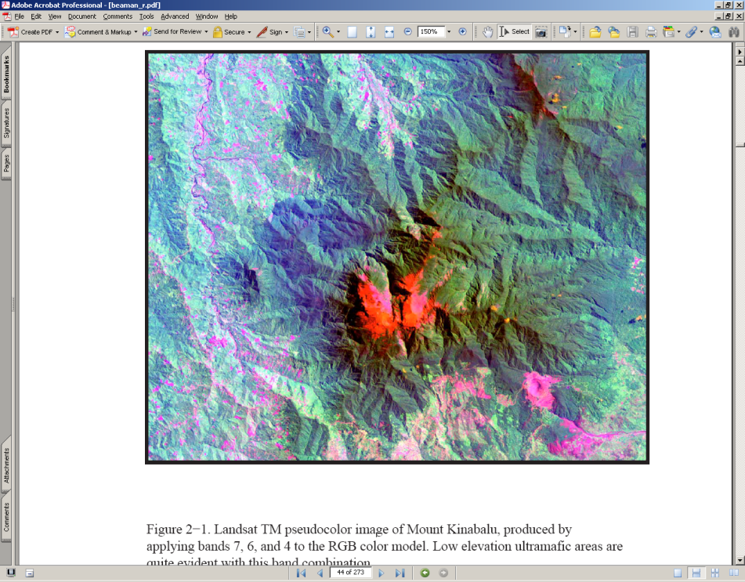
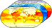
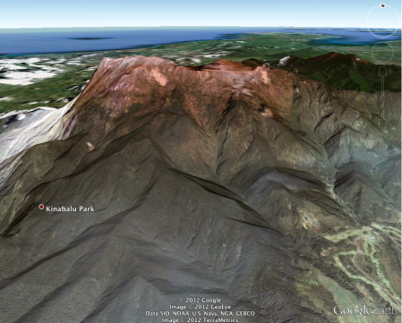
Lifemapper: LmSDM: Species Distribution Modeling
Species Occurrence Data
SDM Modeling Algorithm
Predicted Habitat
Environmental Data
Notes:
For those of you unfamiliar with Lifemapper, it is a 2-fold project
First is an archive of projected species distributions – maps indicating areas where species can live based on where they’ve been found and the environmental conditions there.
These maps are projected for both current climate conditions and future climate conditions predicted by Global Climate Models using scenarios defined by IPCC.
The inputs to this archive include
specimen locations aggregated by GBIF, the Global Biodiversity Information Facility, and
climate data from Worldclim and predicted future climate data from modeling centers
Second is a set of tools and data for researchers
GBIF occurrence data assembled by species
Current Climate data from Worldclim, and Future climate data, assembled from GCM outputs
LmSDM Tools allowing Species Distribution Modeling (aka ENM, PDM, etc) from our data, or user-uploaded data
LmRAD Tools allowing analysis of multiple species (1000s to 10s of 1000s) over multiple areas at multiple scales
Our guiding principal in everything we do, is standards – both in data formats and communication protocols

Slide 10
Biodiversity Expedition Data Prep
Input data
Requirements for Occurrence points
Requirements for Environmental Layers
Modifications for Mt Kinabalu data
Extensions to Lifemapper core
Notes:
The input data for our biodiversity expedition is accepted in standard formats
For point data, We accept shapefiles, CSV, or XML files
For environmental layers, we accept standard raster formats
We made minimal modifications to the Mount Kinabalu data, simply editing the projection metadata
We did some needed extensions to LM core, allowing any projection

Slide 11
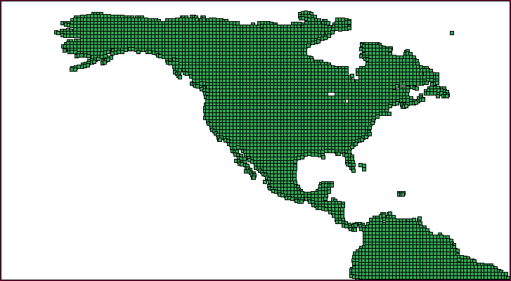
PAM Basics
The world is divided in an equal-area grid of cells
The PAM is a binary matrix. δ_{i,j} notes presence or absence of each species j in each cell i
The marginals provide site-richnesses (α_{i}) and the species-range sizes (ω_{j})
β_{W} = 1/ω∗
Species
A
1
0
1
1
3
B
1
1
0
0
2
Sites
Richness
C
1
0
0
0
1
3
1
1
1
6
Ranges
Notes:
We’d like to continue with a more-extensive proof of concept to increase the communication and automation b/w PRAGMA and LM
This will rely on metadata which we’ll get to in a minute
It will also utilize our LmRAD module for a more interesting experiment
There are several ways of studying biodiversity patterns. We use one centered on Presence-Absence Matrices (PAMs)
PAM is a grid of grids- generally, a very large object.
Many interesting properties are contained in vectors calculated directly from the PAM, including covariance between communities, covariance between distributions, distribution of each species, richness of each site,
From these vectors, most indices follow, quantifying the relationship between taxonomic identity and spatial location
As the analyses are performed at increased extents, resolutions and taxonomic range, the computational demands increase non-linearly
Previously, we were in a pre-industrial stage of Macro ecological analysis
A laborious, inefficient and error-prone process
Must have all data local – now can address remote data through URLs
Grids can be created for square or hexagonal cells, any AOI, any resolution
Intersect 1000s of layers at a time – tested with 1038 – took 8 minutes
Null model creation (randomizing the PAM to assess the statistical significance) was limited to @ 300 x 400 cells, now 2 algorithms will randomize PAMs with millions of cells

Slide 12
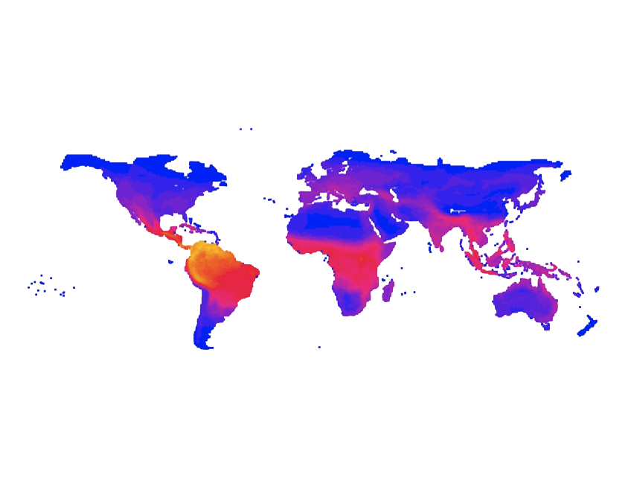
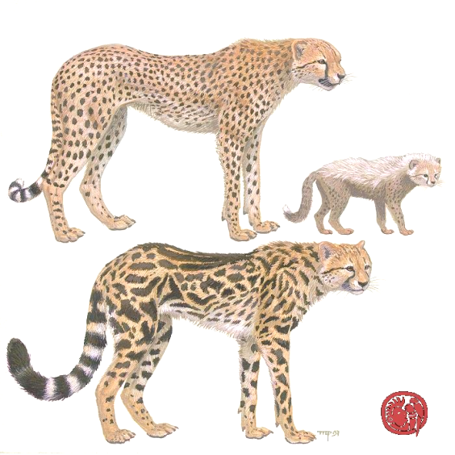
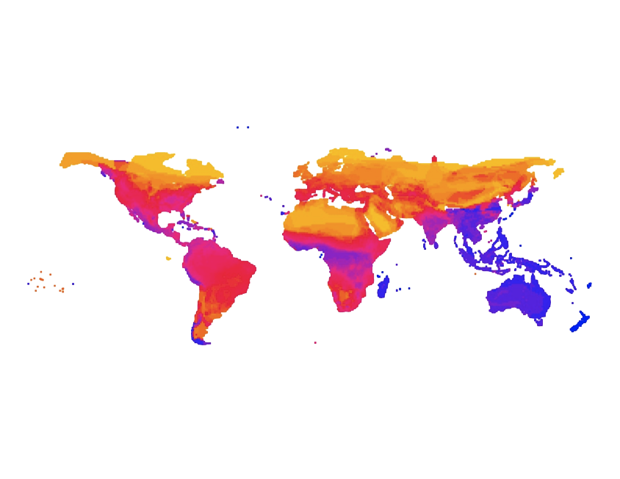
Terrestrial Mammals
Proportional Species Richness
High Yellow
Moderate Red
Low Blue
Per-site Range Size
Notes:
These are just a couple of quantifications that can be visualized after analysing the PAM.
This map, with blue indicating low values and red indicating high values illustrates one principle of species richness and range size
Areas of high species richness, diversity are composed of species with very small range sizes, such as the most diverse area in the world, here in the Andes along the northern portion of South America
Areas where most of the species have large range size, such as the Arctic, have very low species diversity
Another thing I’d like to point out is that this experiment contains 3,617 species and 16,420 cells for a total of over 59 million elements. Many (if not all) existing desktop softwares are unable to perform these analyses because of the size of the data.

Slide 13

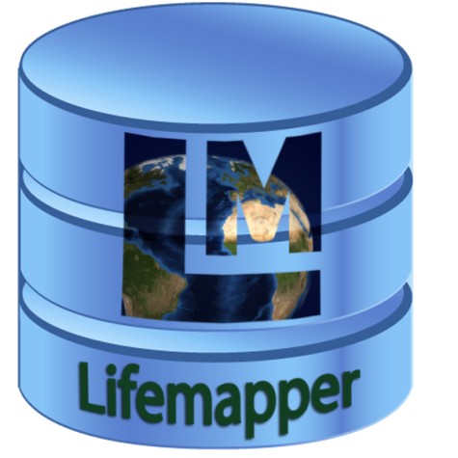




Design for Collaboration
Data Archive
13
Notes:
Web Service advantages
Providing all data and tools through web services was a deliberate choice meant to
mitigate the problems encountered with calculating measurements for very a large number of species, a large geospatial extent or high-resolution area.
Web services ensure that others can take access of the services with their own clients, such as simple scripts.
Some researchers may want to run experiments with so many species that adding and parameterizing each data layer manually is overwhelming. A script could automate presence/absence constraints to account for individual data values
A script could also allow a parameter sweep to create many comparable experiments or experiment components (buckets) that vary with species composition or in a single critical parameter.
Our web services rely on standards, for data, processes, and protocols. This ensures that we are compatible with a wide array of applications and …
Using web services is also a way of maintaining connections to the community, both in terms of easily accepting web-enabled data services, and also incorporating direct queries to PRAGMA, DataONE and other data infrastructure projects. Our commitment to standards means that we can be both a data source and sink, providing and accepting data in standard formats, with standard metadata, and using standard protocols.
Our decision to go with a web services architecture also enables our collaboration with the PRAGMA group, the Pacific Rim Grid and Middleware Applications group. Our first collaboration with them includes a proof-of-concept workflow that takes PRAGMA working group data, sends it through the Lifemapper pipeline, then retrieves that data to catalog it in the PRAGMA accessible GeoPortal.
Users can upload data inputs directly to our data storage or point to remote data using common file transfer mechanisms, such as HTTP or OGC spatial data services.

Slide 14
Cataloging Metadata
Metadata repositories are crucial to preserving scientific investments in data by enabling metadata collection, long-term preservation, and reuse of scientific data

Slide 15
Esri GeoPortal Server
Open source metadata server that enables discovery and use of geospatial resources
Uses emerging standards such as Open Geospatial Consortium (OGC)'s Catalog Service for the Web (CSW)
Simplifies the cataloging and avoids staleness of metadata

Slide 16
The workflow (Demo)
Notes:
Step 1:
A script running at the Indiana University (IU) PRAGMA node queries the GeoPortal server running at UTM. Retrieves metadata describing raster datasets of Mount Kinabalu, environmental and satellite data, and point occurrences of specimen collections
Step 2:
By analyzing the resulting metadata records, the script downloads the datasets stored in a Dropbox location
Step 3:
Script posts the data sets as occurrence sets to the Lifemapper instance running at University of Kansas. Using the returned occurrence set identifiers, the script submits post experiment requests to Lifemapper
Step 4:
Script retrieves metadata results returned for each Lifemapper experiment
Step 5:
Script catalogs provenance metadata describing each experiment, along with the URL for Lifemapper prediction outputs, in a GeoPortal server instance running at IU

Slide 17
Open Problems
PRAGMA Cloud Security
Data are sensitive in that they reveal ecologically sensitive information . What are the cloud security measures to be taken for controlled access of sensitive data?
Agreements on Core Metadata
Discovery and reuse of scientific outcomes from these applications depend on automated or manual extraction of rich metadata about the datasets and prediction outputs. For this to happen, some agreement must exist on core metadata.

Slide 18
Open Problems
Ownership of Results
When analysis is carried out on PRAGMA cloud, the resulting dataset can contribute to enriching the data of the cloud.
How is ownership and sharing tracked?

Slide 19
Open Problems
Metadata Catalog Federation:
We demonstrated use of two GeoPortal instances. What is the PRAGMA-wide solution for metadata catalog federation?
Using GeoGrid?
Discussion during Resources and Data Working Group Breakout Session Thursday 11:00 – 12:00

Slide 20
Future PRAGMA Biodiversity Expedition
Extend for multiple Mt. Kinabalu species
High resolution grid
Extend metadata
To automate data ingestion
To more fully capture provenance of outputs
For transparent, reproducible science

Slide 21
Thank You!

